Slide 1


Titolo presentazione sottotitolo
Software Presentation 2024
Group name: PolimiGeo
Project Subject: Flood Risk Assessment
Milano, XX mese 20XX
Seyed Mohammad Moein Peyghambar Zadeh: 10921320
Saeed Mehdizadeh: 10891394
Hadi Kheiri Gharajeh: 10946669
Vanessa Goletti: 10706682

Slide 2

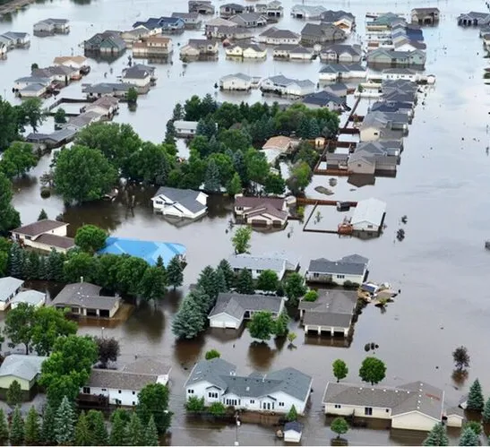
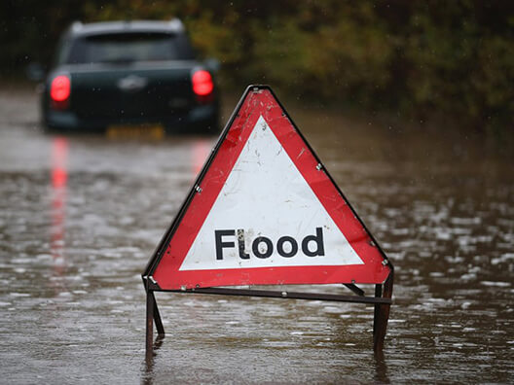
Introduction
Flood risk assessment is a systematic process of evaluating the potential hazards, vulnerabilities, and impacts of flooding in specific areas.
The use of geospatial data and software engineering for flood risk assessment is important for several reasons:
User-friendly Interface
Decision Support Systems
Environmental and Economic Benefits
Accurate Data Analysis and Modeling
Regulatory Reporting
Community Engagement

Slide 3
Flood Risk Assessment
It is the process of visualizing the impact of flooding in specific geographic areas.
This involves collecting and processing geospatial data and presenting this information through an interactive web application.
The design of our system is composed of four parts:
User Authentication | User Dashboard | Flood Risk Visualization | Admin Capabilities
Sign Up | View Dashboard | View Flood Risk Map | Update GIS data
Log In and Log Out | Adjust Parameters | View Analyzed Reports
User Roles |  | Download Reports (e.g. CSV)

Slide 4
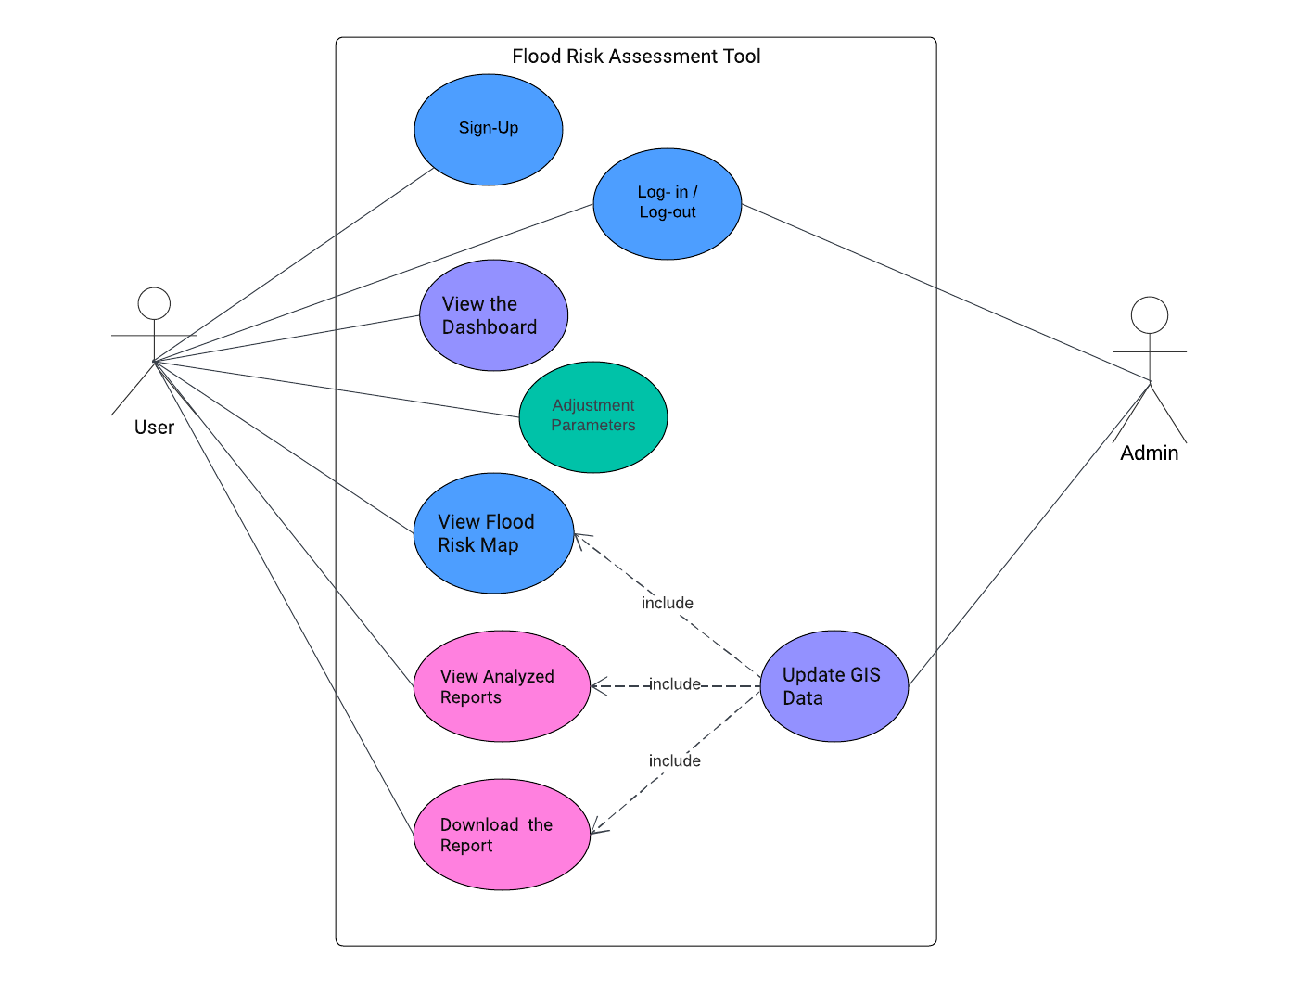
Requirements and Use Case Diagram
Functional Requirements:
Sign up the web application
Log in and log out the web application
View the dashboard
Adjust the parameters
View flood risk map
View analysed reports
Download the reports
Update GIS data
Non-Functional Requirements:
Fast response times
Secure user authentication
High reliability
Technical Requirements:
Data is acquired from the IdroGEO website
Utilize Python libraries such as Pandas, GeoPandas
Use Case Diagram

Slide 5
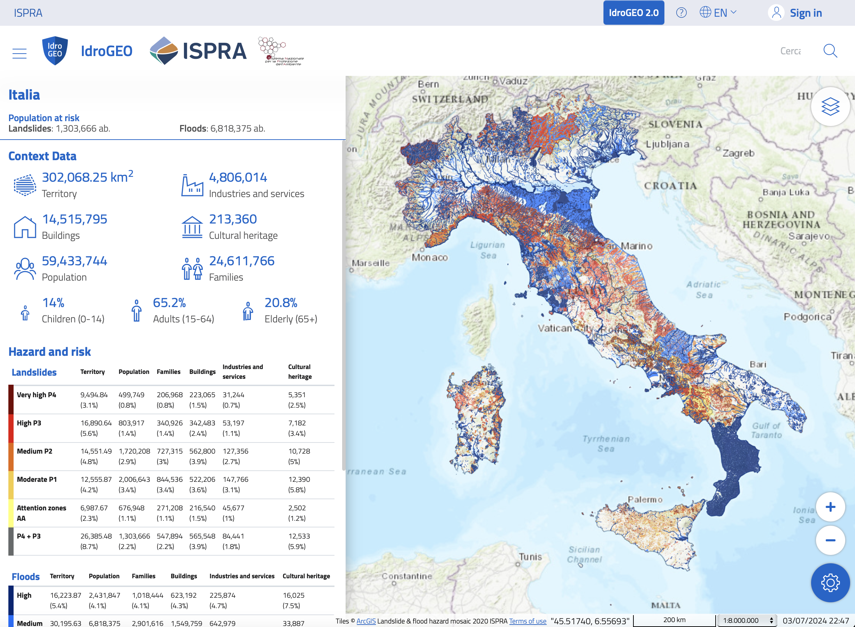
IdroGEO API
IdroGEO API:The Italian Institute for Environmental Protection and Research (ISPRA) IdroGEO API is used for data related to the flood risk such as the building and families that are at the risk of flood.

Slide 6






The libraries used in the system
Libraries:
Flask
Pandas
Geopandas
Folium
Plotly
jupyter

Slide 7
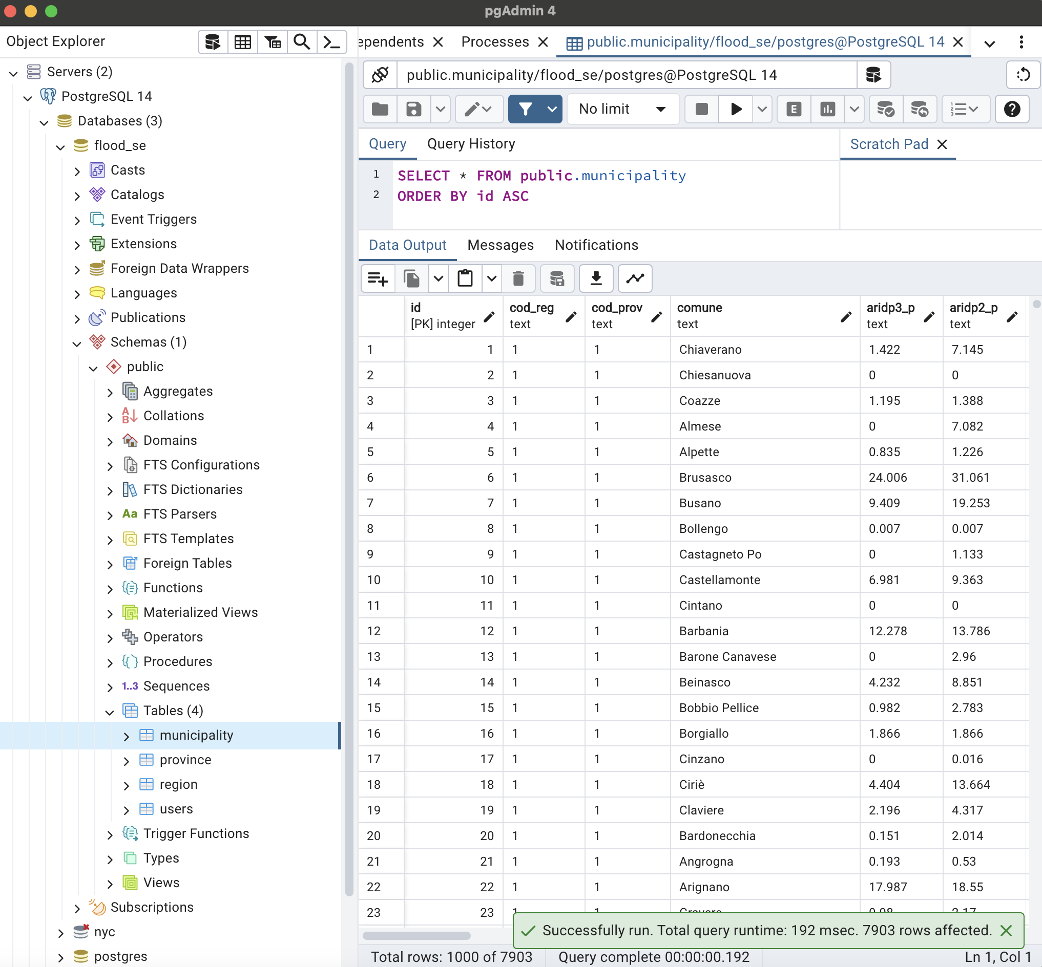
pgAdmin
pgAdmin: it is an open-source administration tool for PostgreSQL database.
After creating the database in the pgAdmin and running the code, four tables with the name of Municipality, Province, Region and User will create in the tables

Slide 8
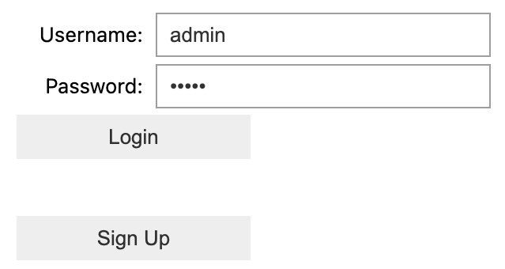
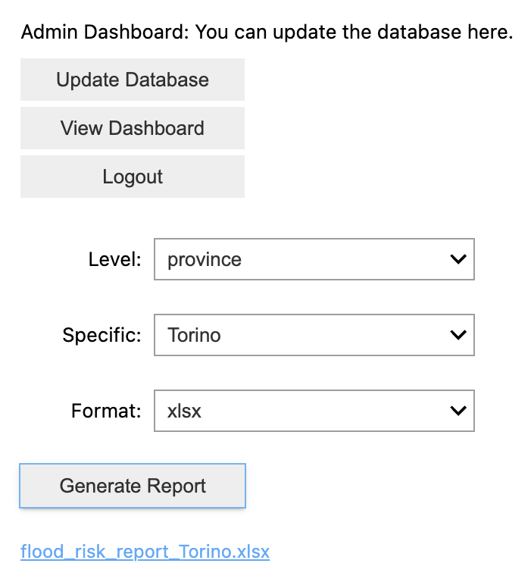
Designed System
Information provided by the designed system:
the factors are at the risk of flood
Percentage of area
Population
Families
Buildings
Business Units
Cultural Heritage
Utilized filters:
In terms of administrative level
Municipalities
Province
Region
In terms of generating report
Xlsx
CSV

Slide 9
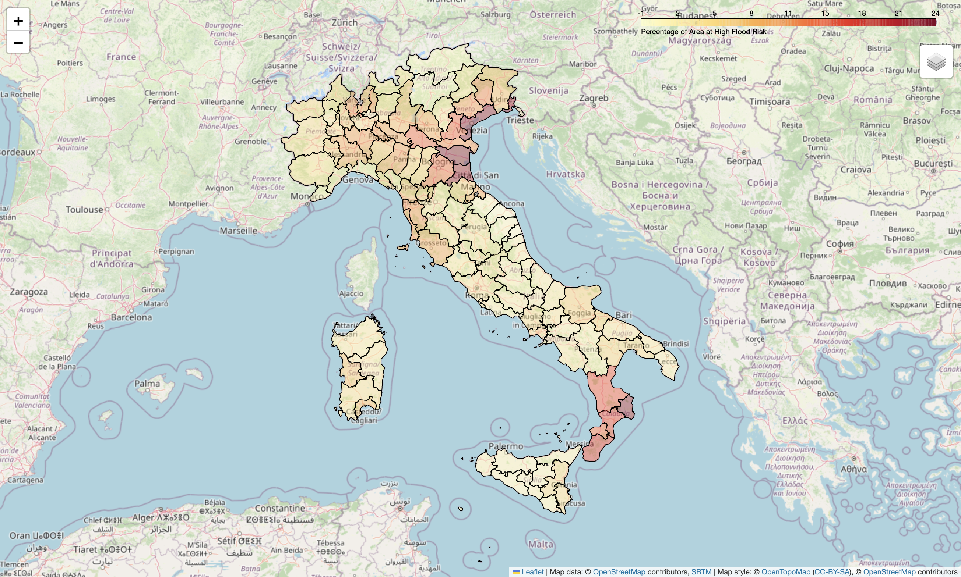
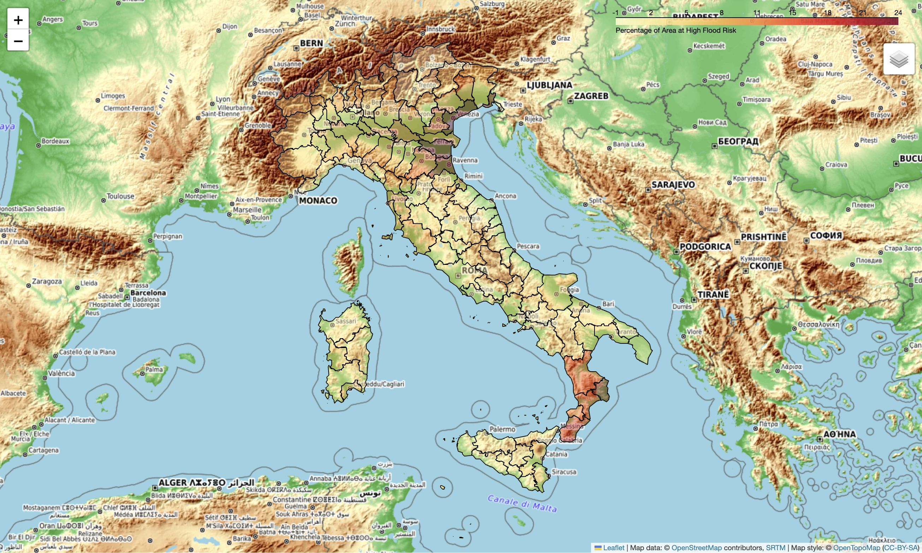
Map Generation
The map generated in the designed system consist of two layers
OpenStreetMap
OpenTopoMap
The open street map layer based on the province level
The topography map layer based on the province level

Slide 10
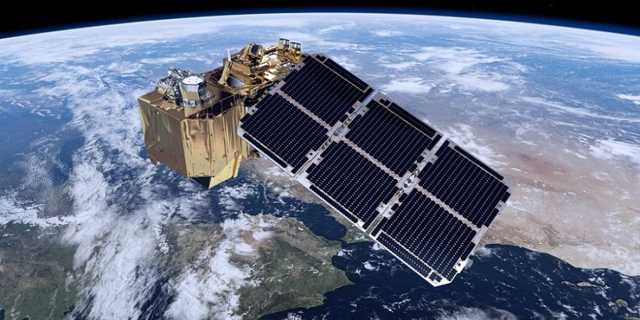
End of the presentation
Thank you for your attention

